Slide 1
Capstone Final Project Presentation Project Title : Kanban Board Presented by Team-01 1.Sharath T 2.Shubham Kumar 3.AnandhaPadmanaban B

Slide 2



Introduction about Team Members
Shubham Kumar
EN12024079061
T.Sharath
EN12024078850
AnandhaPadmanaban B
EN12024078880

Slide 3
Introduction about the project
Kanban board is a visual tool used in project management to track and manage work efficiently.
It consists of columns representing different stages of workflow, with cards or tasks moved across the board as they progress.
Kanban promotes transparency, collaboration, and helps teams prioritize tasks, identify bottlenecks, and improve workflow efficiency.

Slide 4









Technology Used: FrontEnd Backend DataBase

Slide 5
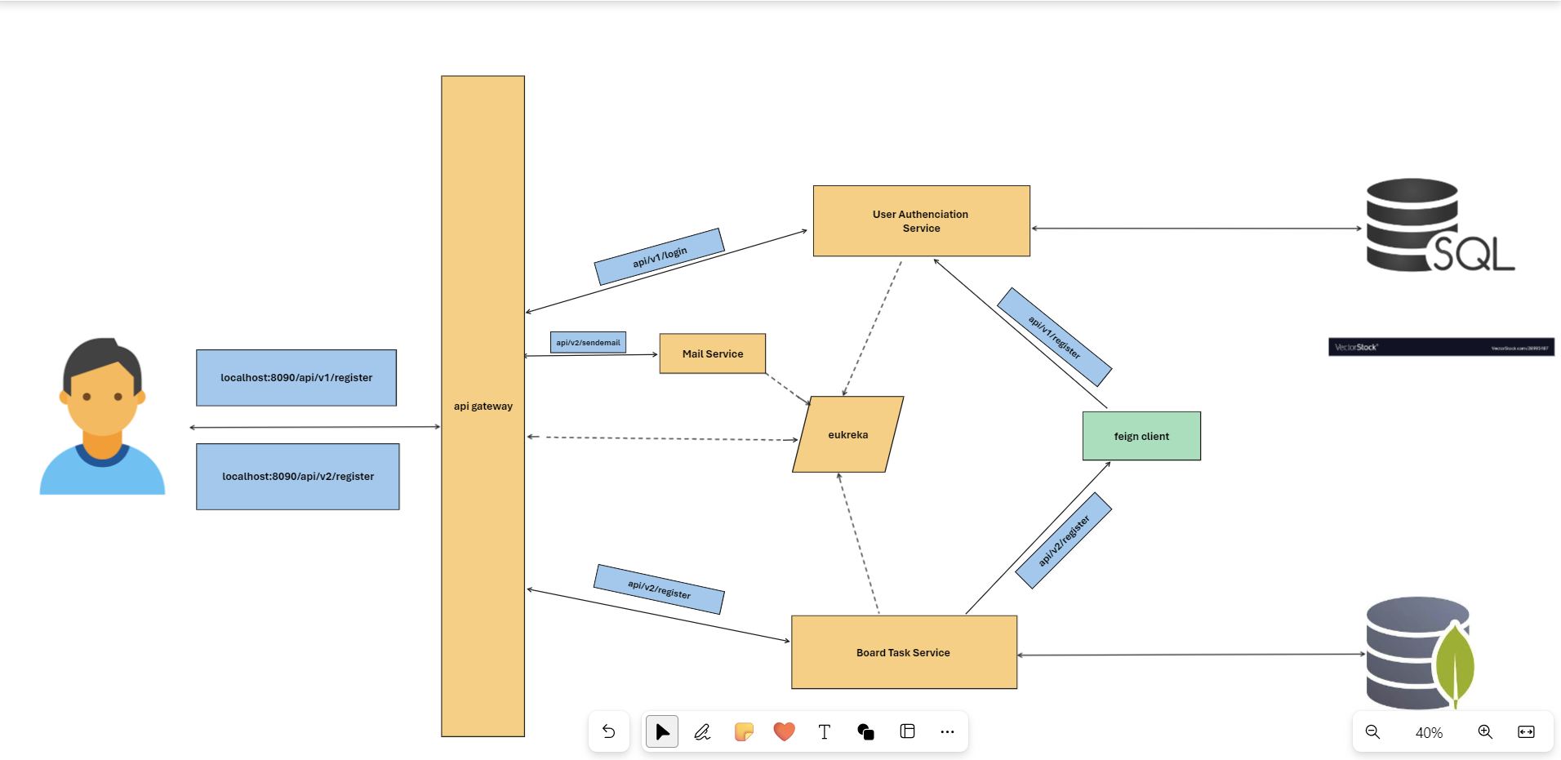
Backend flow:

Slide 6
Front end flow
In our Angular Kanban board project, we've structured it into several key components to streamline functionality. The flow includes:
Home
Login
Dashboard
Header
Register
Add Task

Slide 7
Demonstration

Slide 8
Future Enhancement:
In our project , we will work upon on the multiple admin, edit and delete , search part so that admin can delete and edit the task
We have planned to add more column button for admin to create more column if he wants...

Slide 9
Any Questions?

Slide 10
Thank You

